Slide 1
STYLE SAMPLE
WHERE WE LEFT OFF
five asks · the test each was given · today
THE ASK
TEST SET IN ADVANCE
TODAY
OVS RECOVERY
detect + recompute + install = 51.75 s
ANSWERED
it balances · 87% is detection
FASTER DETECTION
false positives, not detection time
ANSWERED
3.9× faster · idle false positives 0
FAST BUILD DEFAULT
L0–L4 suite passes on the fast build
PREREQ
binaries separable · suite not run
SFLOW JITTER
one fabric · swap kernel, then rate
ANSWERED
inherited · stops paying at 1-in-32
TRUNCATE / MERGE
either moves the ceiling, or cost ≠ per byte
IN PART
truncate: no · merge: wall unmeasured
Three from the 20 August closing slide, two from the meetings since.
1

Slide 2
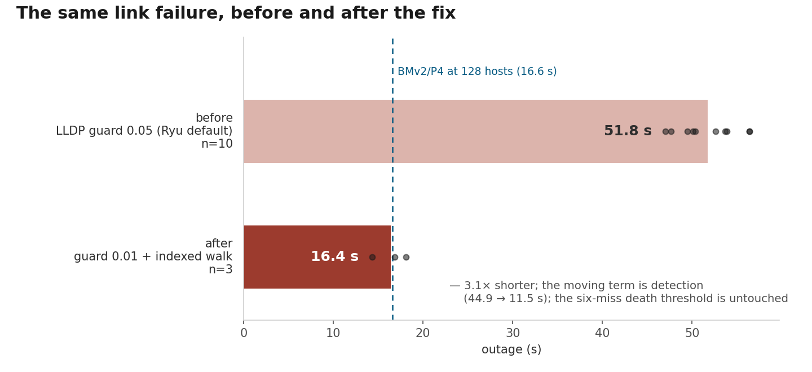
STYLE SAMPLE
THE FAILOVER BUDGET
128 hosts · one inter-switch link down · n = 10
QUESTION
Where do the 51.75 s go?
the test was that the terms add up, not that a cause is found
RESULT
detect 44.9 s · debounce 3.0 · recompute 0.25
SO
87% is waiting to notice · both suspects < 5%
FIX
one constant · probe 0.05 → 0.01 · 51.8 → 16.4 s
LIMIT
idle false positives only · threshold untouched
Decomposition at 4810e8f · detection at 07ae07c · after-fix at 45eccba.
2

Slide 3
STYLE SAMPLE
THE 45-POINT THREAD
one boot · CPU trace and kernel log from the same run
THREAD | 1/1024 | 1/32 | WHAT IT IS
calFlowPathByQueried | 46.31% | 46.84% | 1 kHz path recompute
run | 3.98% | 13.86% | the sFlow ingest
testCalAvgFlowSendingRates… | 0.00% | 0.00% | never runs
purgeIdleFlows | 0.00% | 0.00% | never runs
FINDING
32× the samples · +0.53 points · sampling is not the cost
IT IS
a path recompute at 1 kHz · inherited · present at 28b8b13
INGEST
3.98 → 13.86% · ×3.48 with the rate · this is the cost
NAMED HOW
log and trace from one boot · tid offset moves per build
Measured at 8c0516d · 46.31% falls between the 45.0 and 46.6 published on 20 August.
3

Slide 4
STYLE SAMPLE
PRE-REGISTERED, THEN WITHDRAWN
six cells · two levels · one control
QUESTION
Does the same sample count mean the same precision?
CONFIRMED
pairing held · 0.84% and 0.44% · six cells healthy
ABOUT TO CLAIM
cells not equivalent ⇒ the matrix cannot be skipped
RESTED ON
every pair clearing 0.1 · one cleared it by 0.040
CONTROL
same parameters ×3 · spread moved 0.136 · range 0.240
WITHDRAWN
the threshold cannot separate cell from cell
NOT TAKEN
widening to 0.24 rescues it — registration forbids that
The reversal was already in a draft of this deck. The control is why it is not in this one.
Pre-registration a7c2bd7 · result 8d109f2 · control c62bf3e.
4

Slide 5
WHERE IT STANDS
settled · open · what the next report answers
SETTLED
OPEN
Failover budget
balances · detection 87%
Boot convergence
verified at N = 3 only
Detection
3.9× · false positives 0
Fast build
L0–L4 not run
A sample
206 µs · switches flat
Merge
wired · wall unmeasured
Precision
stops paying at 1-in-32
Ceiling mechanism
receive-side · inferred
Truncation
−5.6× bytes · ceiling unmoved
Scale × concurrency
14% between generations
Concurrency
reads high · four rounds
Loaded false positives
idle only
Residual
3.6 s · unexplained
Marked items are what the next report answers.
5

